Slide 1

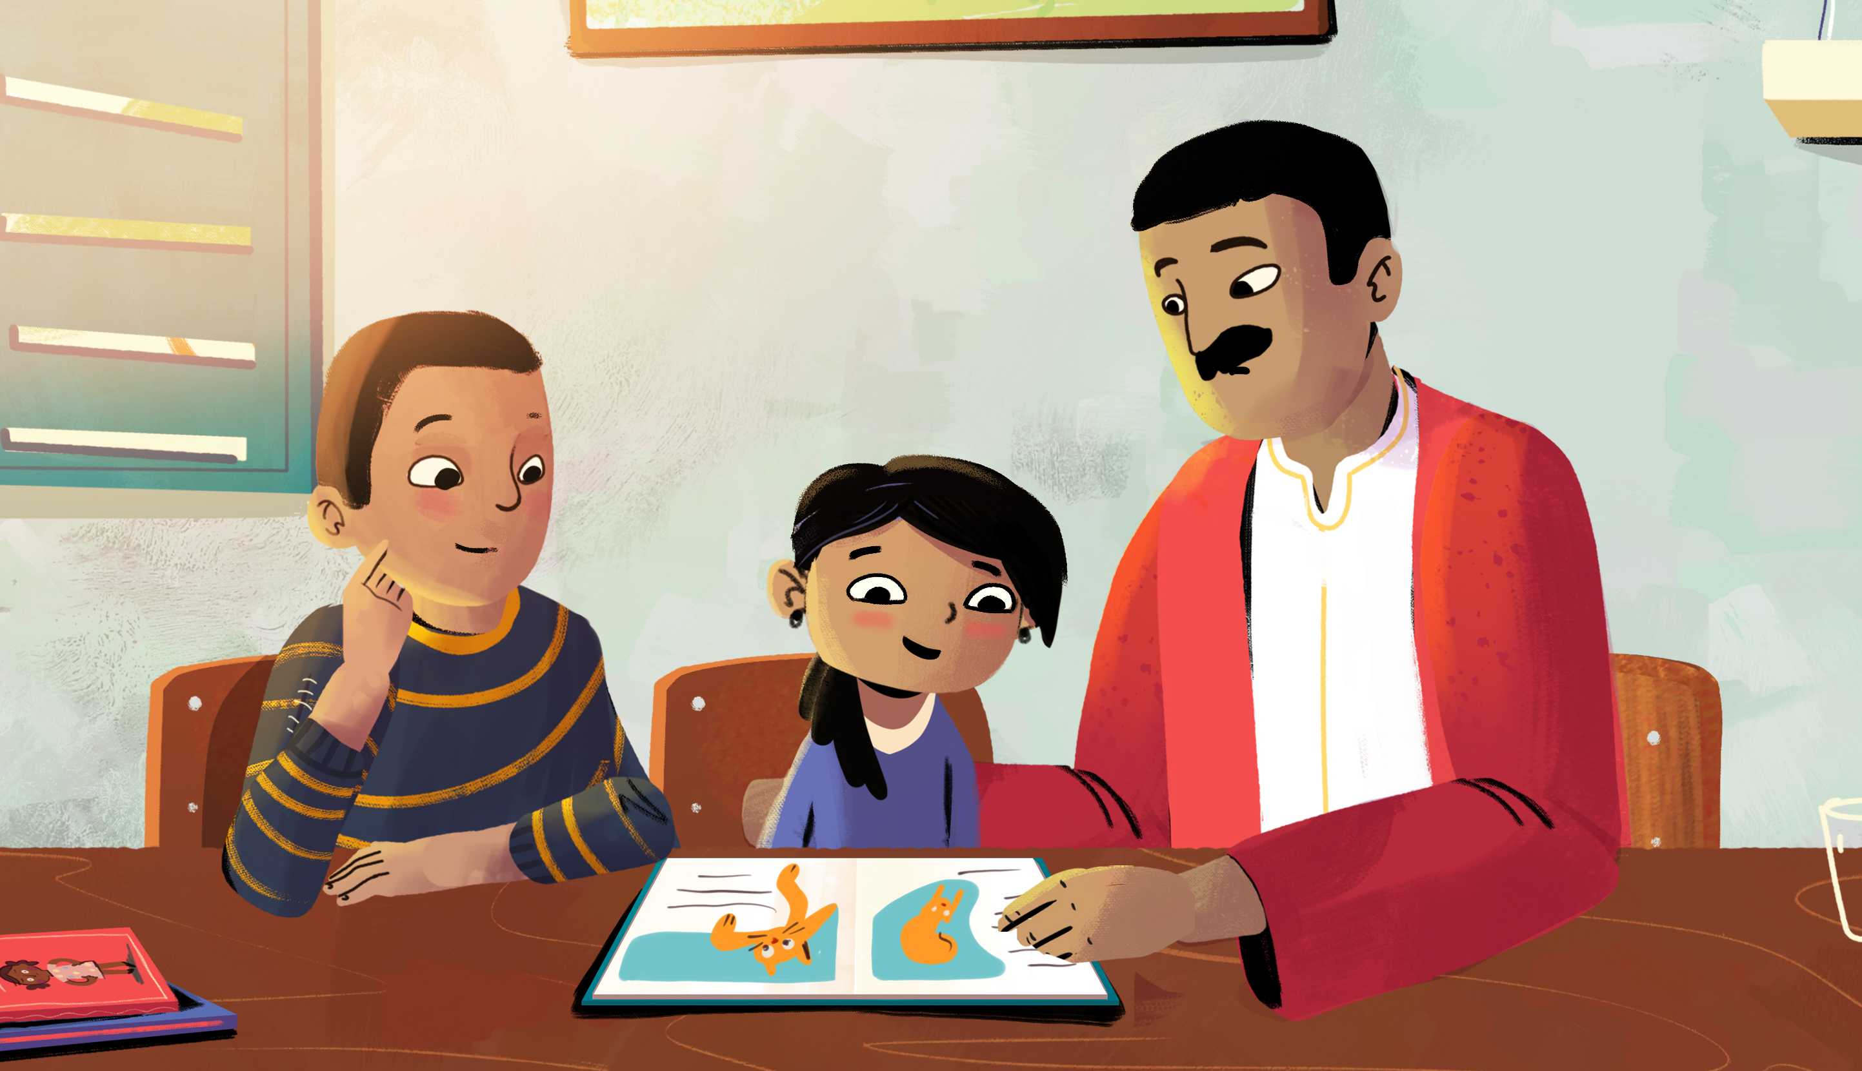
Want to help your child do better at school?
Join the Read@Home Program!
[add details]
[add details]
[insert program logos]

